Slide 1
enterprise mobile applications
enabling business transformation
vinod gadiyaram
19th Feb 2011

Slide 2
corporate wish list
Achieve cost efficiency in every area of operations
Eliminate/Reduce non-productive activities
Enhance returns on capital employed
Sweat the assets – derive more from existing assets
Visibility into ‘on-field’ activity
Real time monitoring of KPIs
Customer delight
Engaged employees

Slide 3
the ecosystem
Mobile Enterprise Ecosystem
Enterprise
Mobile Operator
Enterprise applications
ISVs and software developers
Device OEMs
Peripheral OEMs

Slide 4
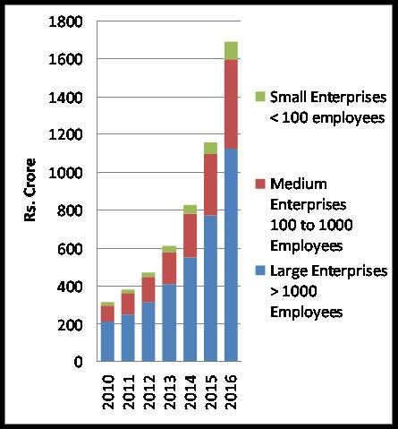
market scenario
Exponential growth anticipated in India
Market size by 2016 > Rs. 1600 Cr²
3G is expected to significantly increase adoption
Source: Gartner
Source: Frost and Sullivan & Yankee Group

Slide 5
market scenario
BFSI and M&D especially pharma verticals were the early adopters
Adoption in Government encouraging – tracking services, NREGA, NRHM, Public Distribution
Early adoption of conventional applications like SFA, bill payments/ receipts/ BI. CRM integration, Queue Buster, LBS soon to catch up

Slide 6
what’s driving adoption?
Tech savvy and knowledgeable workforce
Consumer applications growth can be replicated
By 2015, internet users in India will cross 450 Mn, over 350 Mn will be mobile internet users¹
By 2015, digital content consumption will double to close to $10 Bn in India¹
Lower costs – More bang for the buck!
Cheaper and more powerful smart phones
Lower development costs with SDKs and SaaS offerings, highly skilled developers
Ever decreasing telecom tariffs, technology enhancements like 3G
Evolution in security – encryption, device and application management
By 2013, 80% of handsets sold in mature markets will be smartphones²
Source: 2010 McKinsey Digital Consumer Survey
Source: White paper on Mobile Enterprise Applications – Accenture & orange Business Services

Slide 7
benefits to enterprises
Receive information and capture data at point of activity
Reduce travel costs and paper consumption – go green!
Real-time monitoring of KPIs – faster decision making
Derive more out of existing IT and telecom assets
Real-time visibility into on-field activity
Productivity gains
Time to complete with enablement of field forces
Travelling
Lost time
Reduce human errors
Rationalise support staff – administrative work optimised

Slide 8
benefits to enterprises
Speed up office functions
Lead time to order
Order to payment
Efficient supply chain management
Bill on premises
Reduce fraud
Experience and brand image
Quality of service to customers – less errors, missed appointments, faster processes
Responsiveness to customers
Employee experience – safety, autonomy, sense of accomplishment and pride
More user-friendly and fun workplace
Allows work from home and helps retain talent
You come across as an innovative organisation!

Slide 9
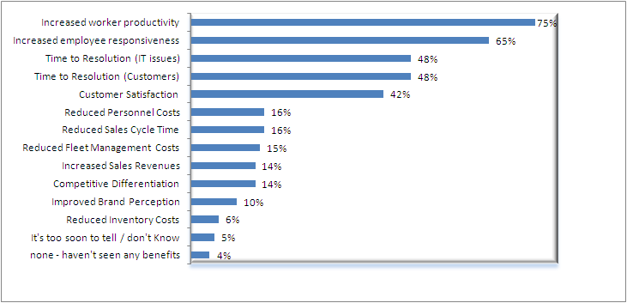
so we are all here to stay!
Ever increasing mobility of field-force – mobile enablement must for productivity
Businesses want to be more efficient – replicate successes within organisation and among peers.
Source: Forrester Research Inc.

Slide 10
common applications
Manufacturing & Distribution
Sales applications – lead management, DSR
Order Management
Media & Services
Service-force automation
BFSI
Collection efficiency solutions
Personnel and Vehicle Tracking solutions
Logistics force automation
Research field force automation
Insurance claim automation
KYC and verification applications
Government & utilities
Supply Chain Management
Wireless POS
AMR
NREGA, NRHM, PDS
Horizontal apps
Business Intelligence
HR process automation
Business workflow applications
Notes:
10

Slide 11
SaaS offerings from TSPs
Single ownership for end-to-end solution delivery and support
Ease of scaling up
Great reach
Large, trusted, stable partners to deal with
Leverage on multi-pronged relationships with the operator
Flexible business models can be offered by the operator
Lower TCO with operators having greater bargaining power with partners
Huge investments by operators on cutting – edge technology and platforms
Domain expertise
Strong OEM partnerships
Notes:
11

Slide 12
enterprise mobile apps from airtel
Airtel for business
1
End-to-End solutions with single ownership
Device agnostic
OS agnostic
Backend application agnostic
Airtel BASE
Blackberry devices
Hosted at customer location
Templatized applications
Customized applications
MDS
Airtel MATE
Mobile / PDA / Laptop /
POS devices
Hosted at Airtel DC /
Customer location
Customized applications
© Copyright Bharti Airtel Ltd.
Confidential, Restricted circulation

Slide 13
press releases

Slide 14
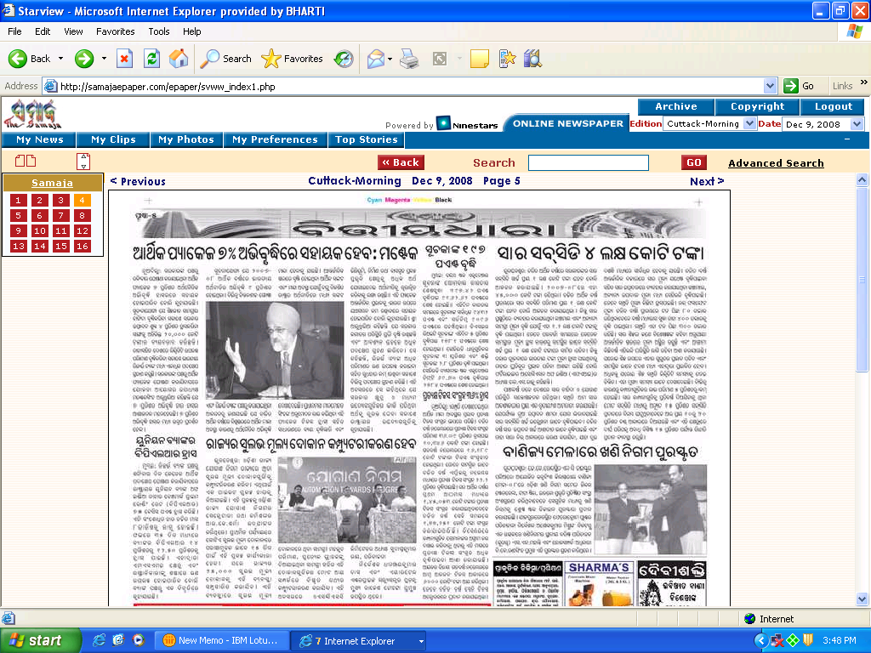
press releases

Slide 15
3G transformation
Media MATE
m Training
Innovation in advertising
Rural education

Slide 19
So … It’s Time To Re-think
Time to Re-consider your IT investments
Business outcome-oriented utility models
Time to Re-duce your physical footprint
Location-independent, virtualize, outsource mix
Time to Re-view /automate your business processes
Mobility-ready, context-ready, flexible, efficient & cost effective
Time to Re-align your IT priorities
From “best” practices to “next” practices

Slide 20
Improved Process
Field executive goes to office
Cases Assigned
Visits Customer
Update status on mobile device
Goes back to office
Form Collected
Data Entry
Data Analysis
Fills paper form
Services Customer
Report Creation
Reports Distribution
Notes:
20

Slide 21

BASE : A Live Case Show
Bangalore Traffic Police
Click here

Slide 22

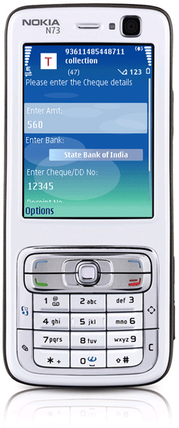
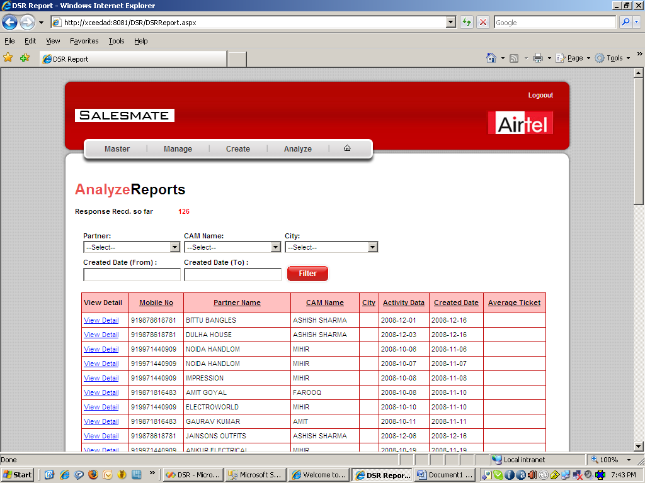
Track MATE
Consignment Tracking & Collection Automation
Key Highlights
Case Allocation
Real Time update
Customizable Reports
Manage users
Location Capture-GPS
Print Receipt
Reduced TAT
Secure data transfer
Capture customer photo & signature
Click here to Know More

Slide 23
Verify MATE [AVCV Automation]
AVCV Process Automation
Key Highlights
Case Allocation
Real Time update
Customizable Template
Location Capture-GPS
Reduced TAT
Secure data transfer
Capture customer Photo, ID Proof & signature
Trace fraud customer –Credit Check

Slide 24

Sales MATE [KYC]
Know Your Customer (KYC) Automation
Key Highlights
Key Highlights
Case Allocation
Real time DSA & CPA processing
Reduces TAT
Saves cost
Real Time update
Customizable Reports
Location Capture
Print Receipt
Capture Photograph, Signature, ID proof
Click here to know more

Slide 25
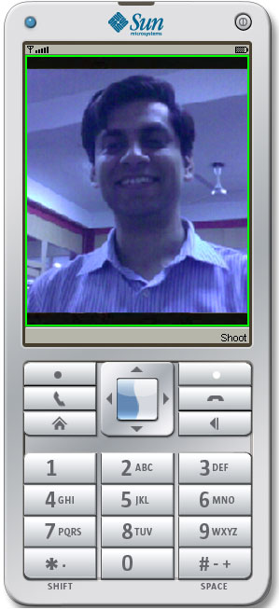
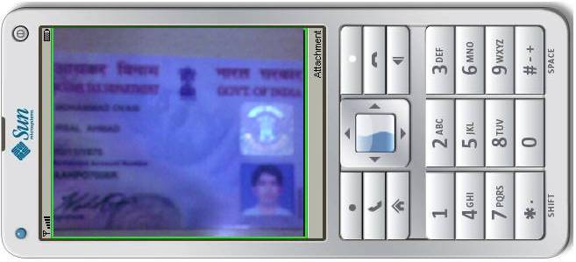
Sales MATE [KYC]
Attach Customer Photo Attach Pan Card Photo

Slide 26

Sales MATE [DSR]
Daily Sales Reporting Automation
Automate Daily Sales Reporting, Sales tracker [Primary, Secondary, stock etc.] from the field.
Key Highlights
Key Highlights
Increase productivity
Efficient reporting
Customer satisfaction
Saves costs
USABILITY
Simple mobile phone can be used
User friendly
Sequential data capture
Capture all mandatory parameters
Seamless integration with existing CRM
Click Here to Know more

Slide 27

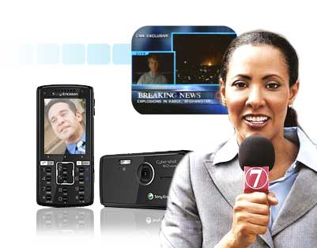
Media MATE
Breaking News Coverage Live from Mobile
Key Highlights
Capture Live news anytime anywhere
Live Video Capture
Secure Transfer
Breaking News
Sting operations
Real time capture
3G Ready
Broadcast feed within minutes of capture
Minimizing operational costs and delay
Global coverage
Reporter activities monitoring using web panel & GPS
Click here to know more

Slide 28
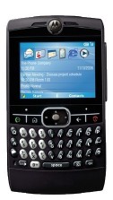
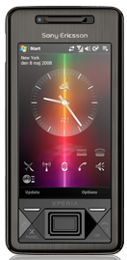
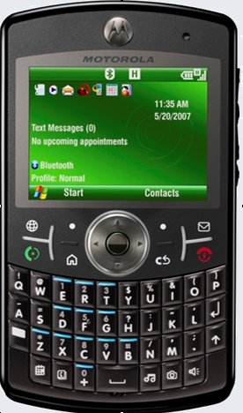
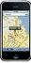
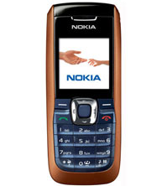
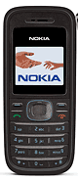
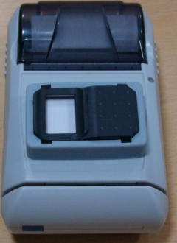
Use Any Mobile Handheld
Bluetooth Printer
Moto Q8
Moto Q9h
Sony Xperia
Nokia - GPS
Nokia 2626
Nokia 1208

Slide 29
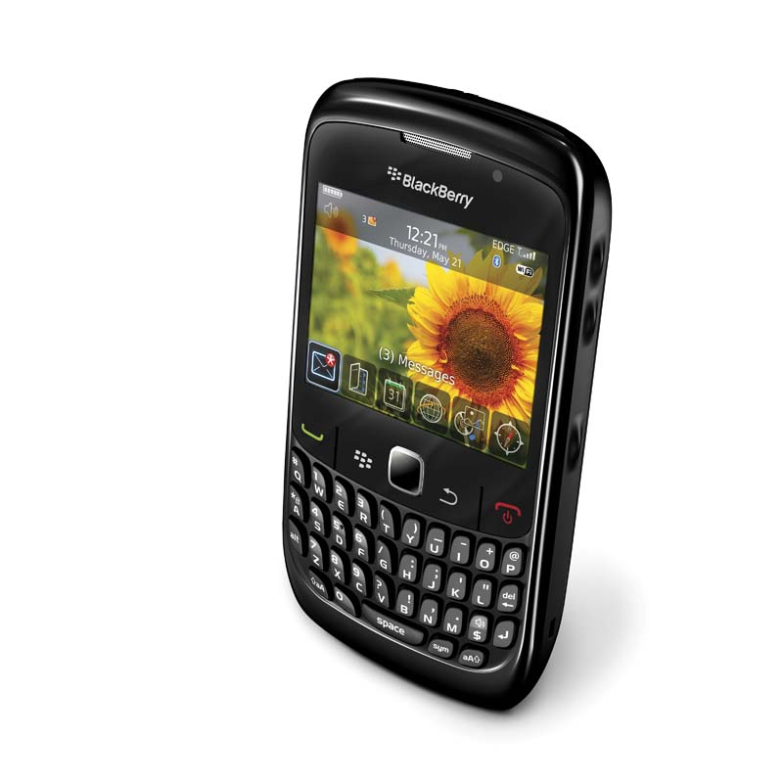
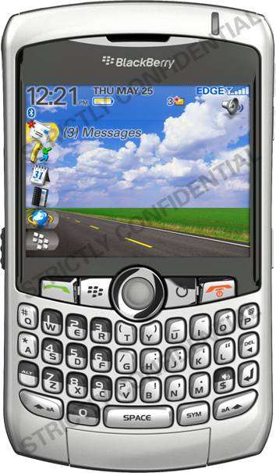
Or Any BlackBerry

Slide 30
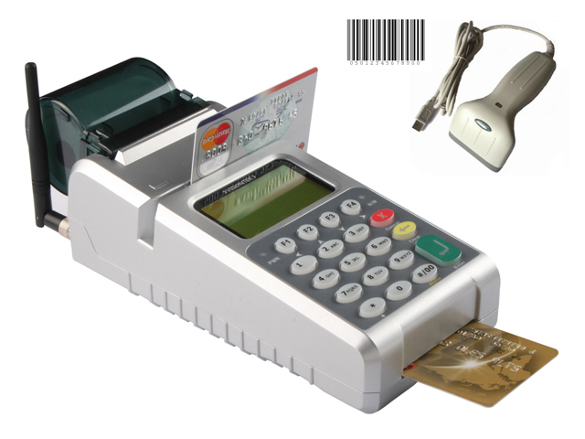

Slide 31


Customer Expectations
Seamless connectivity
Across networks
Across Technologies & Devices
Compelling Services
Not just voice but much more
Business & Lifestyle enabler
Pick & Use
Simple / Auto configuration
Self install
Mobility
Portability, Roaming
Affordability

Slide 32
Challenges
Drivers for the Grand Slam
Voice, Video, Data and mobility …
… from network perspective
…from subscriber perspective
Seamless coverage
Technology maturity
Spectrum
QoS
Interop
Economies of scale
Scalability
Biz model

Slide 33
Wireless Technologies - Evolution
Past
Present
Future
Microwave
Satellite
VSAT
GSM -2G
CDMA – 1x RTT
LMDS, MMDS
Wi Fi – 802.11b
Bluetooth
GPRS, EDGE
CDMA – EV DO
Wi Fi – 802.11a/g
WiMAX – Fixed
RFID
DVB-T, S
UMTS, WCDMA
HSPA, MIMO
Mobile WiMAX
4G, LTE
DVB-S / T/ H
Tremendous transformation in the devices
Manifold increase in bandwidth delivery
Service capabilities & Mobility
Wireless has already manifested itself as the choice of technology for backhaul, last mile, LAN & Personal applications

Slide 34
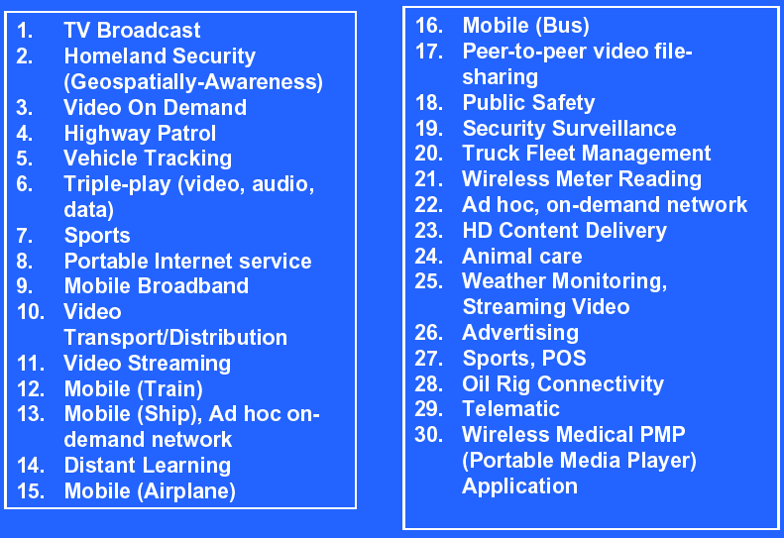
Potential Applications

